Slide 1
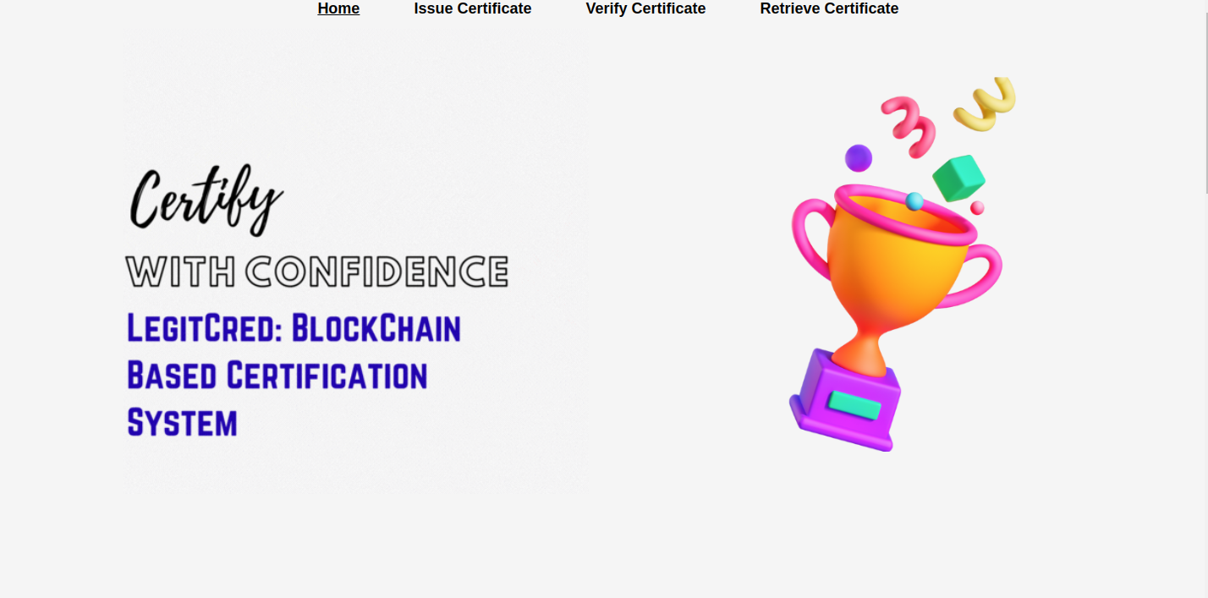
BLOCK CHAIN MANAGEMENTPROJECT NAME:-SKILL VERIFICATION SYSTEM

Slide 2
Introduction
Educational certificate verification verifies the legitimacy of graduate students' certificates. University authorities invest millions annually in maintaining the costly, lengthy, and time-consuming process. Employers dedicate ample time to examine the legitimacy of applicants' certificates.The existing certification system offers traditional certificates to candidates. This is why certificates can be tampered with and lost at any time. Additionally, the process is risky due to counterfeit certifications given by scammers and illegitimate entities. Many people fabricate certificates to lie about their degrees and qualifications. Fake certificates, created by skilled scammers, are difficult to identify and address. Therefore, upgrading the certification and verification procedure is essential. This article introduces a Blockchain-based decentralized DIUcerts platform providing an easy way to issue, check, and verify educational credentials. DIUcerts reduces data storage by storing certificate information in separate files, while the Ethereum platform handles issuance and verifications. Using this technology, maintaining a Blockchain-based certificate verification system is far less expensive than using a centralized database. DIUcerts can improve security, reduce costs, and save time for verifying educational certificates.

Slide 3
BACKGROUND STUDY
A. Blockchain
A Blockchain is a decentralized, shared, fault-consuming, and append-only database that tries to manage the records in blocks. For any kind of transaction, Blockchain doesn’t need to be dependable on trust. Solving the problem regarding double spending is one of its features. Furthermore, it has a benefit like the recording of any transaction is not transferable to a third party as long as the valid core of the system manipulates the power of the CPU. In a time of need, nodes can join or exit the network. Achieving the majority by voting with CPU power, a valid block is detected and others are said to be invalid. Blockchain provides the feature of numerous applications like Decentralized Applications, crossborder payments, asset management, supply chain, and logistic monitoring, voting system,
Architecture of Blockchain
The architecture of Blockchain includes a database and network of nodes. A Blockchain database is split, faulttolerant, append-only, and distributed. All records are perpetuated in blocks. Though users approach the blocks, they cannot expunge them. Each block is connected to one another by chain and they all have unique hash values.
Smart Contracts
The digital quality of Blockchain has led to it being attendant with smart contracts. A deal with the corporal world is a covenant among parties that executes certain proviso and the transfer of an asset will happen. To initiate the asset transfers and meet the validated conditions by machines, the code of smart contract codifies these attributes. Additionally, by processing or validating the contractual transaction, the Blockchain platform may furnish the computational materials where other parties are fascinating in the transaction, thereby gaining a stake in the transaction to verify the ledger

Slide 4
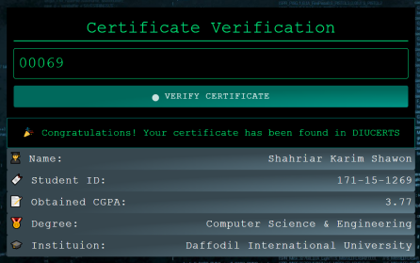
METHODOLOGY & MODEL DESIGN Methodology
The proposed methodology utilizes Blockchain technology through the functionality of a decentralized application using a smart contract and developed based on an Education certificate verification and creation system.
All transactions recorded and verified on the Blockchain cannot be modified, hacked, or deleted. The main purpose of the proposed DApp is to empower the educational certificate verification system to a trustable platform and reduce the complexity and server maintenance cost of the system.
platform with the help of HTTP, WebSocket, or IPC. We also deployed the smart contracts through the Remix IDE. This DApp was first tested on the Ropsten Test Network before executing on the Ethereum Mainnet. For performing the Blockchain transaction, we choose Metamask which is a crypto wallet & gateway to Blockchain apps.

Slide 5
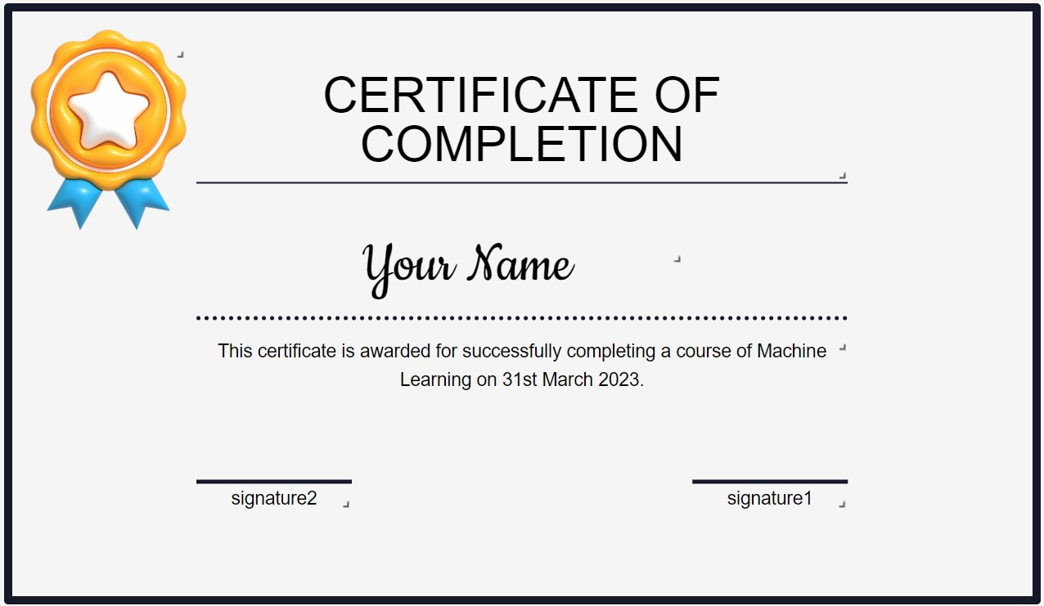
IMPLEMENTATION & EVALUATION A. Implementation
Modern web applications are based on such a foundation in which a single case of downfall normally exists. DApp aims to reduce these problems by distributing crucial components that store data of infrastructure between various nodes. For this reason, when developing DApp we should be taken into deliberation the security, cost, usability, complexity features
Tools and Technology used in DIUcerts DApp:
Blockchain Framework: Ethereum
Language for implementing smart contracts: Solidity
IDE for deploying smart contracts: Remix IDE
Ethereum wallet: Metamask
Blockchain Network: Ropsten Test Network
Front-end: React.JS
Web Technology: Web 3.0
Web 3.0 Module: Web3.JS library, web.th

Slide 6
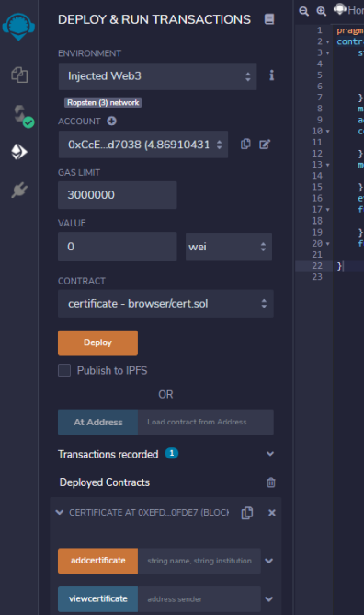
Building Smart Contract
Solidity language is used for writing and developing the smart contracts in DApp applications. Remix is extremely suitable platforms for creating, managing, testing and deploying of the smart contracts. When we used Remix IDE in the web browser as a web application, we can also use Visual Studio Code in offline on a computer. These two are the perfect combination for building Decentralized Applications

Slide 7
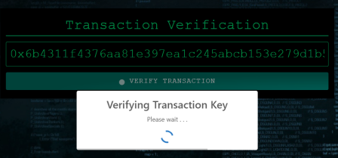
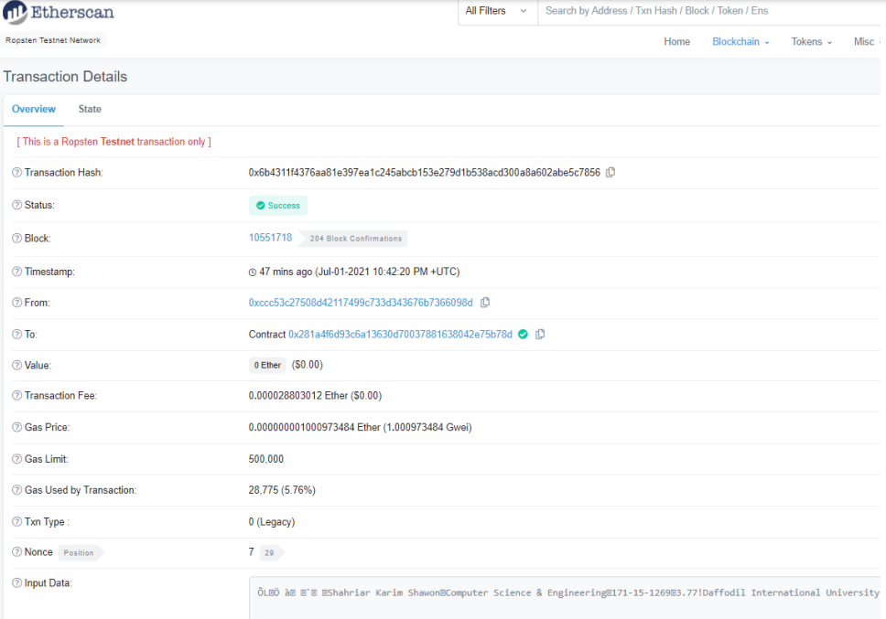

Slide 8
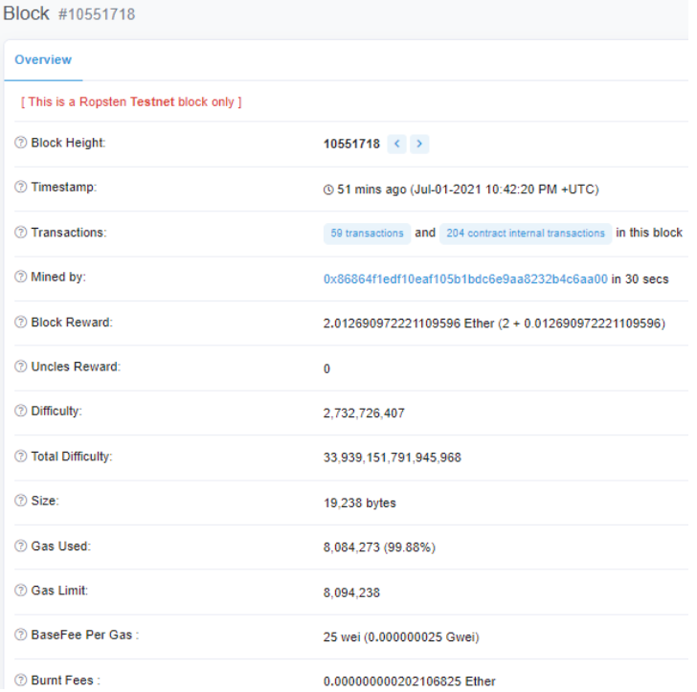
Conclusion
Graduate student certificates are verified by educational credential verification. Each year, university authorities spend millions on this costly, complex, and time-consuming process. The employer takes time to verify the applicant's certificate. Candidates receive traditional certificates under the existing system. Certificates can be tampered with and lost anytime. The process is also risky due to scammers and illicit entities forging certificates. People often forge certificates to misrepresent about their degrees. Skilled scammers create fraudulent certificates that are hard to spot and handle. Thus, certification and verification must be improved. This presentation proposed a Blockchain-based decentralized DIUcerts platform for quick educational credential issuance, verification, and checking. Each certificate's information is maintained in a separate file, and DIUcerts issues and verifies certificates using Ethereum. This architecture reduces the cost of operating a Blockchain-based certificate verification system compared to a centralized database. DIUcerts improves security, saves money, and speeds up educational certificate verification.

